Slide 1
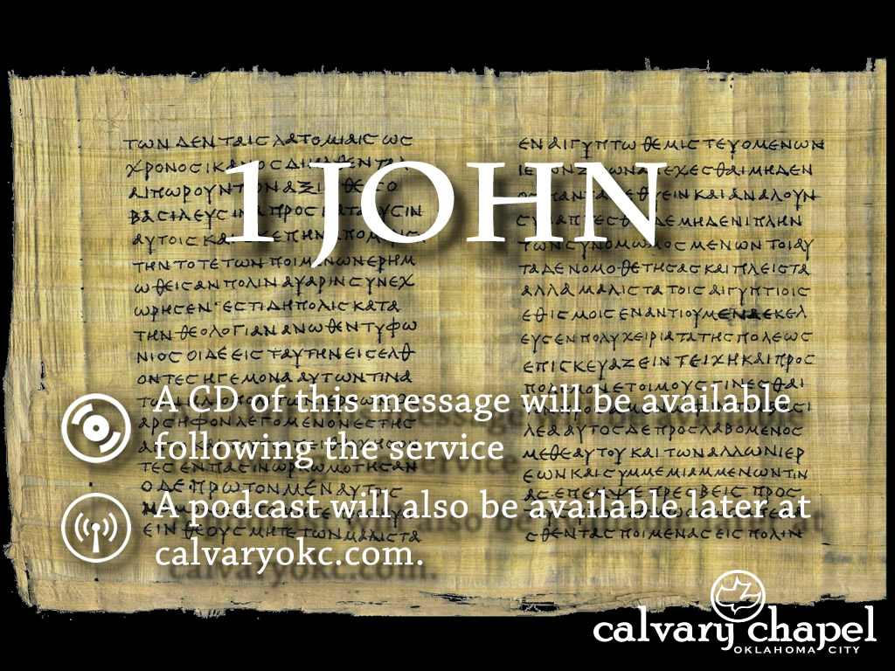
3:1-9

Slide 2
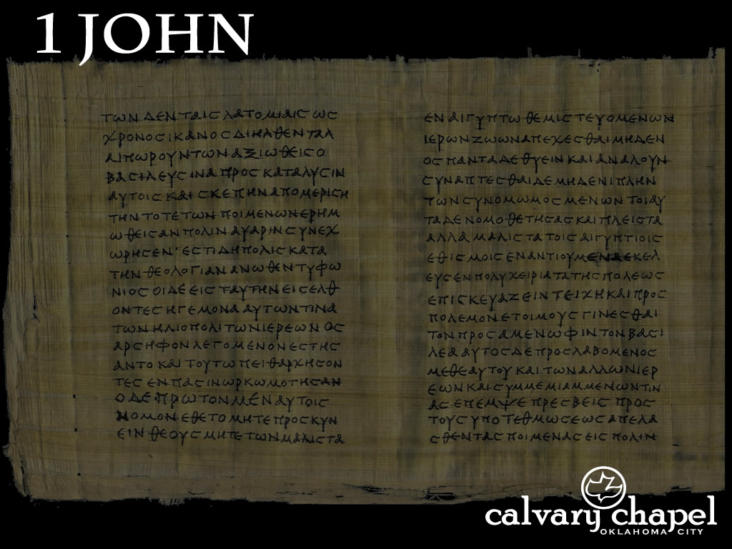
3:1-9
World ~ kosmos – The system that sets itself up as independent from God

Slide 3
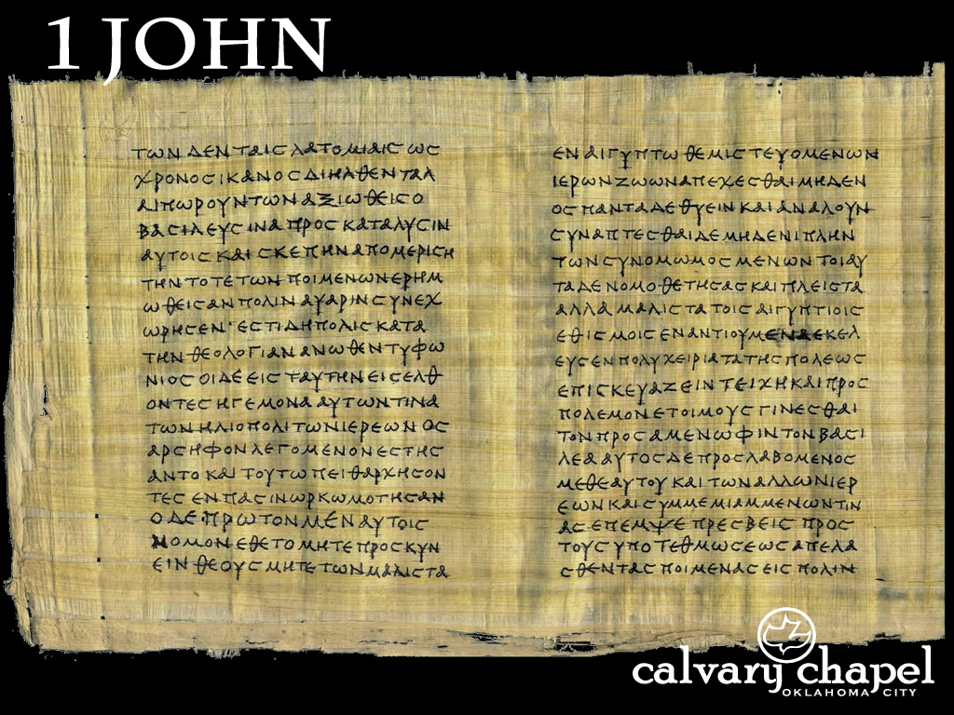
3:1-9

Slide 4
3:1-9
Chapter 1) koinonia; fellowship (3x)
Chapter 2) ginōskō; know, knowledge (7x)
Chapter 3) menō; remain(2:88ff ~ 8x)

Slide 5
3:1-9

Slide 6
3:1-9
Behold ~ literally, sit up and take notice
Manner ~ potapos – pote, when; pou, where
Anonymous ~ “Somebody who really loves you sees what a mess you can be, how moody you can get, how hard you are to handle, but still wants you in their life.”

Slide 7
3:1-9

Slide 8
3:1-9
C. H. Spurgeon – “There, you poor people that love me; you sick people; you unknown, obscure people, without any talent; I have published it before heaven and earth, and made the angels know it, that you are my children, and I am not ashamed of you. I glory in the fact that I have taken you for my sons and daughters.”

Slide 9
3:1-9

Slide 10
3:1-9
1 Tim. 2:5 (Merrihew Standard Version)~ For there is one God and one Mediator between God and worms, the Worm Christ Jesus,

Slide 11
3:1-9

Slide 12
3:1-9
Mark 14:36 ~ And He said, “Abba, Father, all things are possible for You. Take this cup away from Me; nevertheless, not what I will, but what You will.”
Rom. 8:15; Gal. 4:6 ~ Cry out, “Abba, Father”

Slide 13
3:1-9

Slide 14
3:1-9
John Stott – “What we are does not appear to the world; what we shall be does not yet appear to us.”

Slide 15
3:1-9

Slide 16
3:1-9
W. A. Criswell ~ “We won't really know each until we get to heaven.”
D. G. Barnhouse ~ “Do you think we’ll be more stupid there than we are here?”

Slide 17
3:1-9
2 Cor. 4:16-18 ~ ¹⁶ Therefore we do not lose heart. Even though our outward man is perishing, yet the inward man is being renewed day by day. ¹⁷ For our light affliction, which is but for a moment, is working for us a far more exceeding and eternal weight of glory, ¹⁸ while we do not look at the things which are seen, but at the things which are not seen. For the things which are seen are temporary, but the things which are not seen are eternal.

Slide 18
3:1-9

Slide 19
3:1-9
Commits ~ NASB, practices (present, active participle)

Slide 20
3:1-9

Slide 21
3:1-9
Practices ~ same word in v. 4 ~ commits; present, active particple

Slide 22
3:1-9

Slide 23

3:1-9
Destroy ~ luō – to loose or untie
Raise ~ to erect or build; to cause to arise, appear or exist
Born to
Raise
Raze ~ to level to the ground, to demolish
Raze
Hell

Slide 24
3:1-9

